Slide 1
Flooring Mastery Application
Ollie Dickson

Slide 2



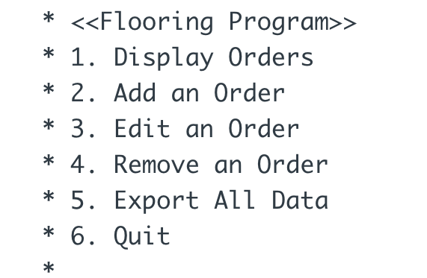
Flooring Mastery Project
The goal of this project was to create an application that can read and write flooring work orders for a hypothetical company.
The application needed to follow an MVC structure, use Interfaces and Dependency Injection.
The application must require validation for user input and any invalid input must be handled appropriately.
Design should include unit testing for the Dao and Service Layer implementations.

Slide 3
Design & Plan for Implementation
UML Diagram & Flowchart
Planned Schedule for Coding Implementation
Class Structure
Dao File Implementation
DI & Controller logic
Controller methods with corresponding methods in view and service layer
Clean and improve functionality

Slide 4
Key Challenges & Learning Outcomes
File format specifications
Validation requirements
Reading/Writing to different files

